Slide 1
Inverse Laplace Transform of Muscle T₂ Data
Eric Hughes 13th March 2018

Slide 2
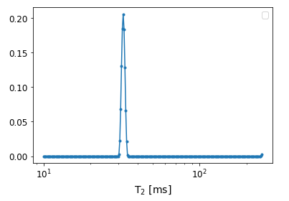
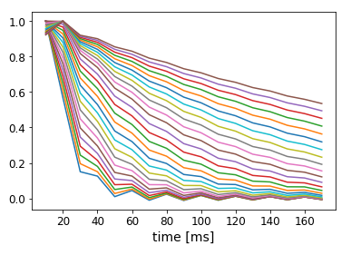
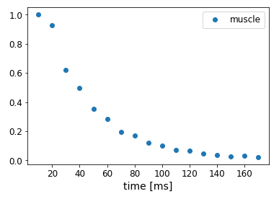
=
x

Slide 3
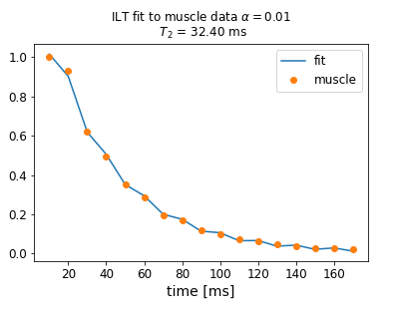
T₂ Distribution

